Slide 1
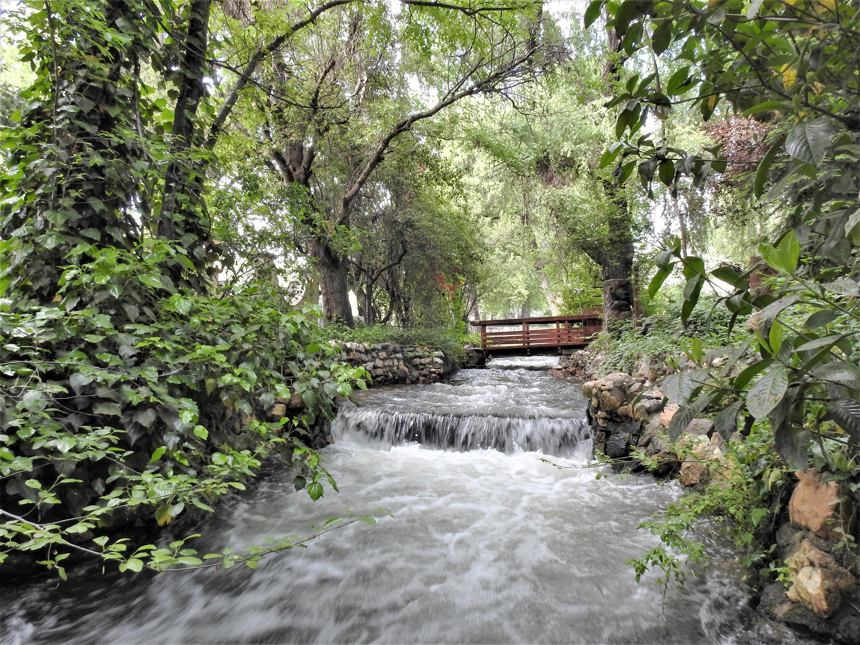

Utica Regular Board Meeting
September 22, 2026

Slide 2
Order of Business
Call to Order / Pledge of Allegiance
Roll Call

Slide 3
Item 3 – Approval of Agenda

Slide 4
Approval of Agenda
  Motion to approve agenda

Slide 5

Item 4 – Public Comment

Slide 6
Public Comment
  Comments are limited to three minutes per speaker.
  Members of the public may address the Board on any item not listed on the Agenda.
    Public comment on agendized items will be heard at the time the item is considered by the Board.
  The public is encouraged to work with staff to put future items on a regular meeting agenda for Board consideration.

Slide 7
Item 5 – Consent Calendar

Slide 8
Consent Calendar
Motion to approve the consent calendar

Slide 9
Item 6A – SDRMA Health Benefits MOU

Slide 10
SDRMA Health Benefits MOU Revision
Motion to adopt Resolution 2026-14 Adopting the Revised SDRMA Health Benefits MOU
Roll Call Vote

Slide 11
Item 6B – Board Member Duties and Responsibilities

Slide 12
Item 7 – Correspondence, GM and Board Reports, Future Items

Slide 13
7A – Correspondence

Slide 14
7B – General Manager Report

Slide 15
7C – Board Member Agency Reports
City of Angels
Union Public Utility
At Large Director

Slide 16
7D – Future Agenda Items

Slide 17
Item 8 – Upcoming Board Meetings

Slide 18
Upcoming Meetings
Meeting Date:
  Tuesday, October 27, 2026, at 5:30 p.m.
  Tuesday, November 24, 2026, at 5:30 p.m. (consider rescheduling)

Slide 19
Item 11 - Adjournment

